Slide 1
paediatric Rapid Evaluation and ReSuscitation of the Unwell Simulated Patient
Dr F Hignett, September 2017
www.presus.weebly.com – for all slides & handouts

Slide 2
Objectives
To help you throughout your medical student training & on day 1 as an F1, by developing a robust system for assessing an unwell child
Gain experience of assessing, diagnosing and treating acute paediatric conditions through simulation
Recognise when you need to call for help and how to do it
Revise and practice basic life support

Slide 4
The Approach
A - Airway
B - Breathing
C - Circulation
D - Disability
E - Exposure

Slide 5
A - Airway
Patent/At Risk/Compromised
Observation:
Examination:
Talking
Snoring
Stridor
Choking
Vomiting
Foreign body
Vomit

Slide 6
B - Breathing
Observation:
Examination:
Respiratory rate
Colour
Expansion
Work of breathing
Recession
Nasal flaring
Head bobbing
Saturations
Central trachea
Auscultation
Air entry, crackles, wheeze
Percussion
Dull, resonant

Slide 7
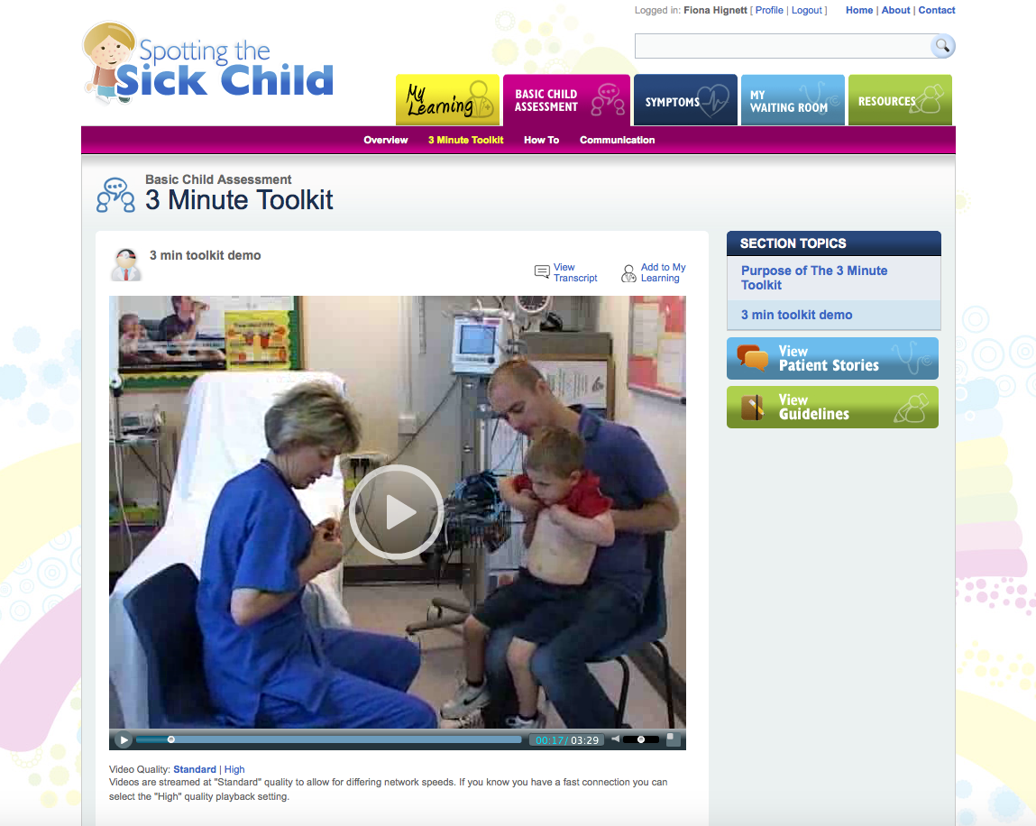
Assessment www.spottingthesickchild.com
Notes:
Link here and log into spotting the sick child and watch the ‘breathing difficulty video’

Slide 8
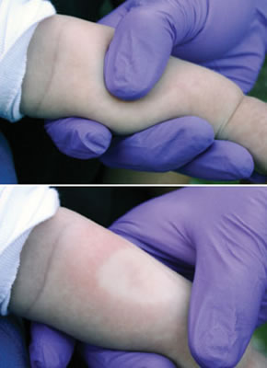
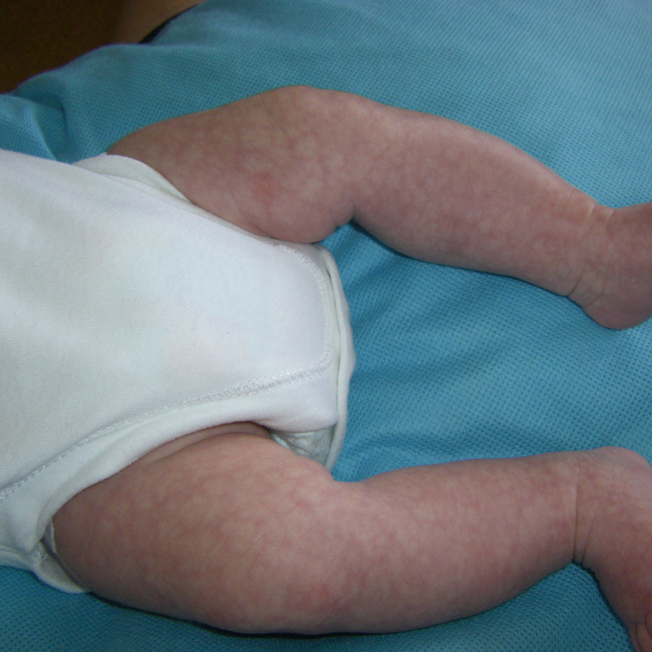
C - Circulation
Observation:
Examination:
Colour
HR
?Sweaty
Urine Output
Pulse
Rate, rhythm, character
CRT
BP
Peripheral temperature
JVP/Peripheral Oedema
Auscultation
Check for hepatomegaly

Slide 9
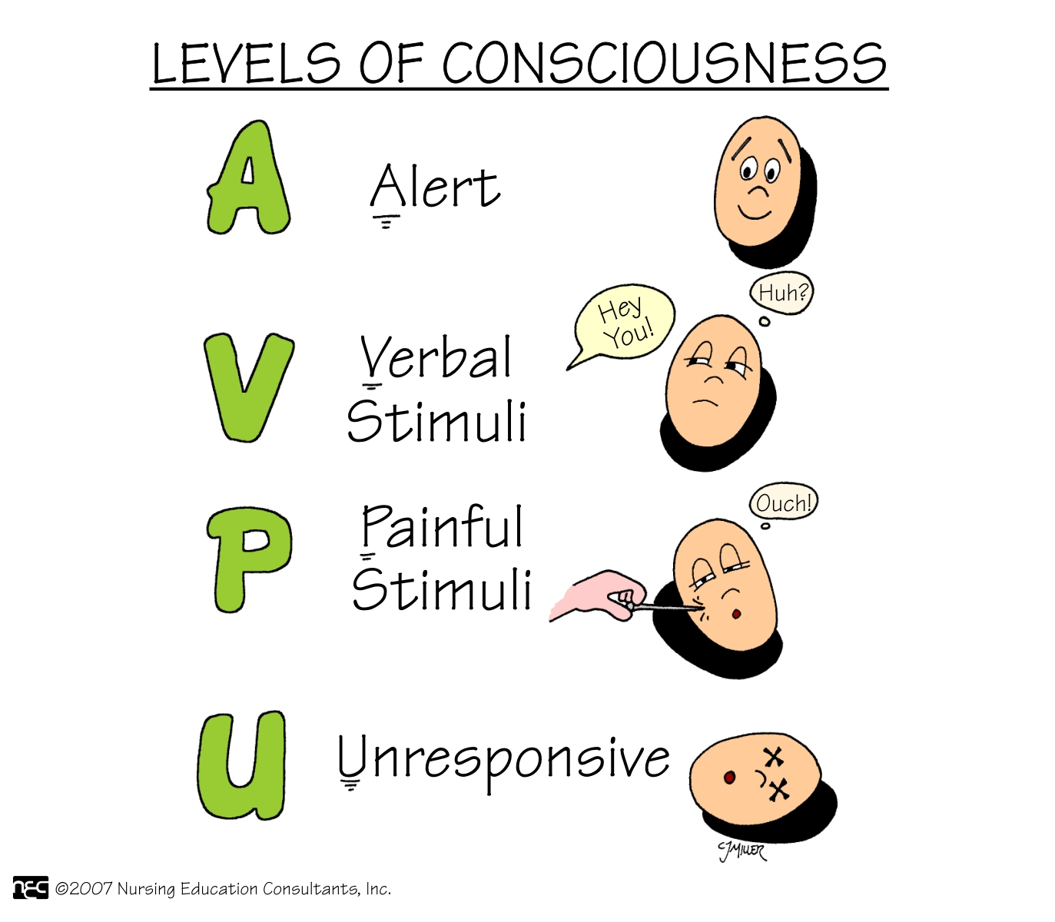
D - Disability
Observation:
Examination:
AVPU
GCS
Eyes
Voice
Motor
Pupils
Temperature
BLOOD SUGAR

Slide 10
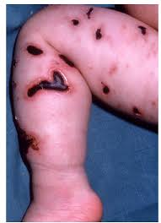
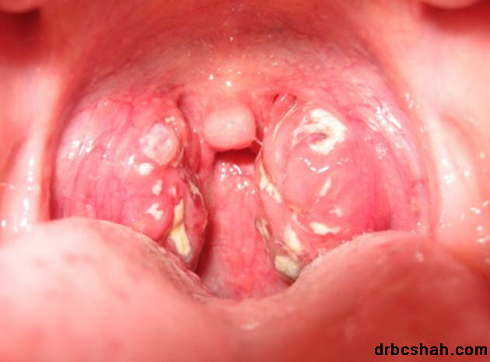
E - Exposure
Observation:
Examination:
LOOK!!
Top to toe
Front to back
Drug chart
Obs chart
Notes
Abdo/GI
ENT
Any other relevant system
Remember to LISTEN to the parents

Slide 11
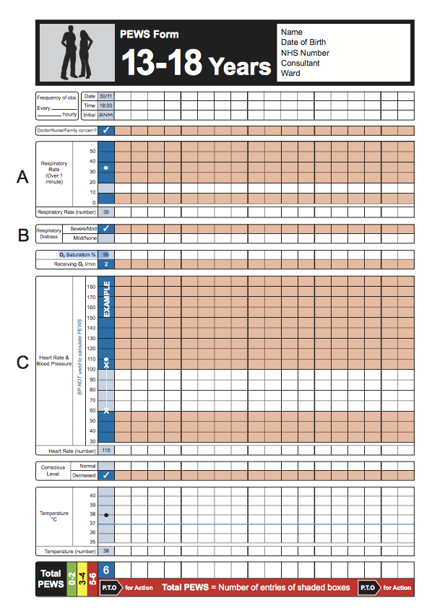
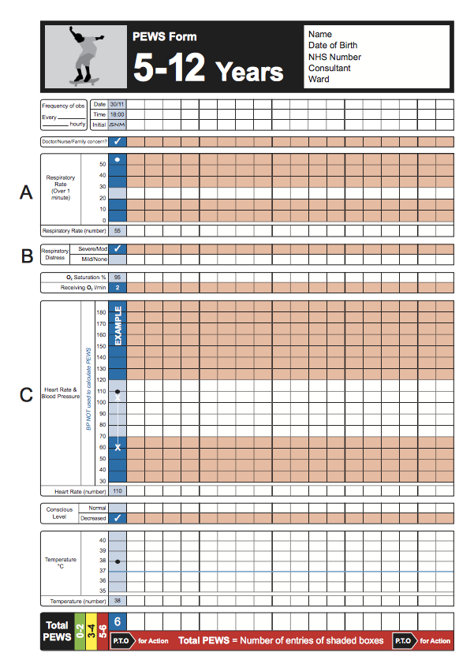
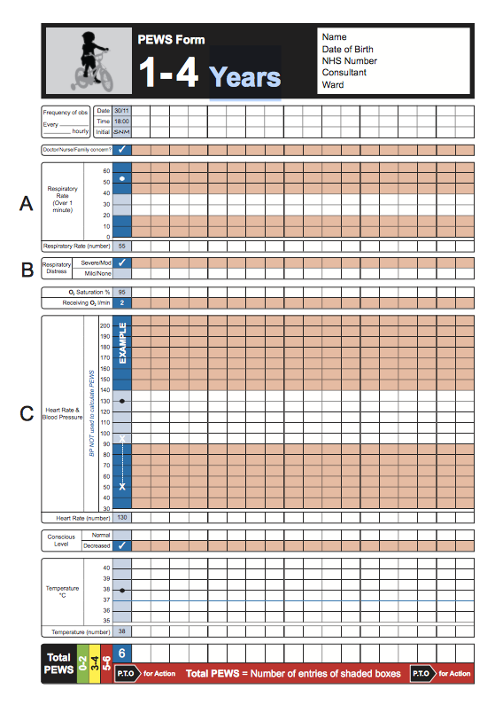
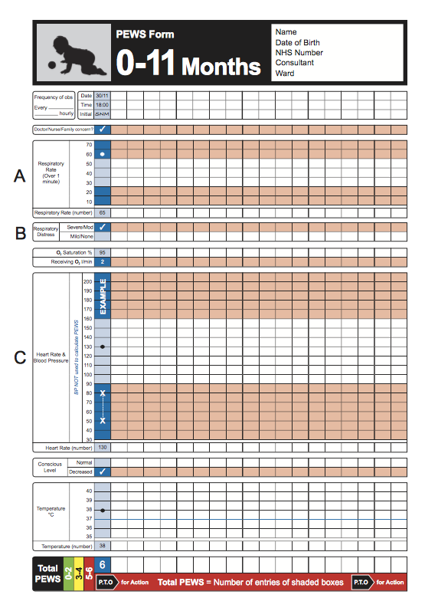

Slide 12
Observations
AGE (years) | HR (min) | RR (min) | Systolic BP (mm/Hg)
<1 | 110 - 160 | 30 - 40 | 70 - 90
1-2 | 100 - 150 | 25 - 35 | 80 - 95
2-5 | 95 - 140 | 25 - 30 | 80 - 100
5-12 | 80 - 120 | 20 - 25 | 90 - 110
>12 | 60 - 100 | 15 - 20 | 100 - 120
Taken from APLS Manual

Slide 13
ASSESS
TREAT
REASSESS
NEED HELP?!

Slide 14
Possible Intervention / Treatment
System | Intervention | Treatment
A – Airway | Airway Adjuncts NIV I&V | Oxygen Nebulised/IM Adrenaline Nebulised/Oral Steroids
B - Breathing | Blood Gas CXR | Nebulise Salbutamol +/- Ipratropium PO/IV Steroids IV Bronchodilators
C - Circulation | Access Bloods, Cultures Lactate Catheter | Fluid Bolus 10-20ml/kg 0.9% Saline IM Adrenaline 10mcg/kg or 0.1ml/kg of 1:1000 Antibiotics
D - Disability | Airway Positioning Immobilisation Recovery Position | 10% Dextrose Bolus 2ml/kg Anti-epileptics Naloxone
E - Exposure | Remove Clothing - Look Top to Toe & Front to Back | Antibiotics Analgesia

Slide 15
WET FLAG – Resuscitation Calculations
WET FLAG | Calculation
W – Weight | 0-12 months – (age x 0.5) + 4 1-5 years – (age x 2) + 4 6-12 years – (age x 3) + 7 (age +4) x 2
E – Energy | 4J/Kg
T – Tube | Diameter: (age/4) +4 Length: (age/2) +12
F - Fluid | 20ml/kg of 0.9% Saline
L - Lorazepam | 0.1mg/kg Lorazepam
A – Adrenaline | 0.1ml/Kg of 1:10,000 Adrenaline
G - Glucose | 2ml/Kg of 10% Dextrose

Slide 16
SORT www.sort.nhs.uk
Advice & Support
Drug Calculator
Guidelines
Notes:
Click link and show them guidelines & drug calculator

Slide 17
ASSESS
TREAT
REASSESS
NEED HELP?!

Slide 18
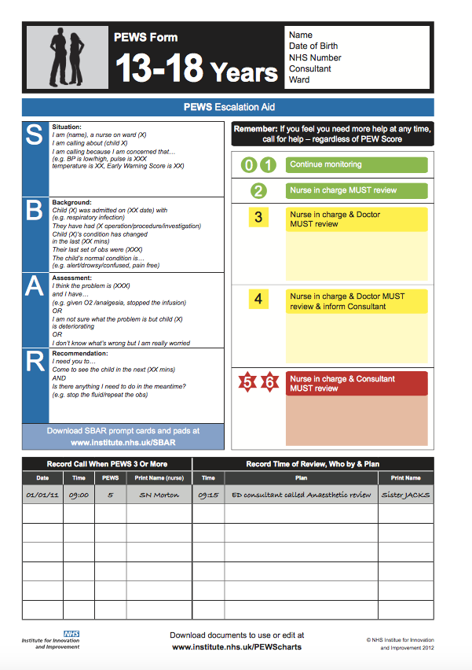
Calling For Help
In SGH:
To Bleep: 1010 or 15-bleep-Ext
Paediatric SHO: Bleep 2212
Paediatric Reg Bleep 2201
Paediatric Cons: Through Switch
Outreach Nurses: Bleep 1442
Paediatric Arrest: DIAL 2222
SBAR
Situation
Background
Assessment/Action
Reccomendation/Result
Notes:
Need to change this slide dependent on your trust!

Slide 19
KEY TAKE HOME MESSAGES…
WHEN IN DOUBT CALL FOR HELP!!

Slide 21
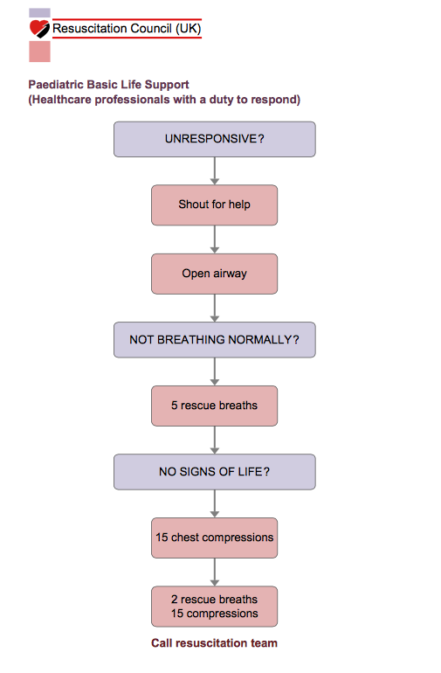
BLS

Slide 22
Meet the Chokeables: https://youtu.be/fpOxPAMWQX8

Slide 23
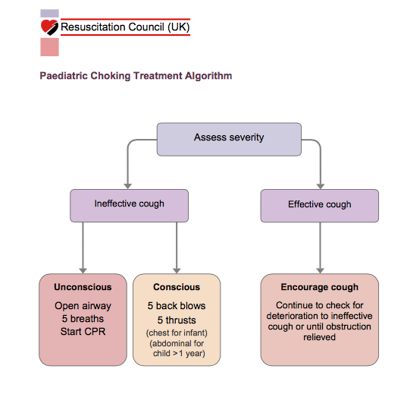
Choking

Slide 24
KEY TAKE HOME MESSAGES…
WHEN IN DOUBT CALL FOR HELP!!

Slide 26
Helpful Resources
Resource | Website | Description
Spotting the Sick Child | www.spottingthesickchild.com | Interactive teaching resource on the assessment of the unwell child
SORT | www.sort.nhs.uk | Advice & referral to PICU Drug Calculator Guidelines
RESUS Council | www.resus.org.uk | Resuscitation guidelines and algorhythms
BNFc | www.bnf.org | Medication dosing
pRESUS team | Email: pRESUScourse@gmail.com | For advice about the pRESUS course, pursuing a career in paediatrics or any paediatric related queries!

